Slide 1
StockPre
568 Software Engineering 2 Web Application
Group #4: Cheng Chen, Chenfan Xiao, Jianing Xu, Xinyu Li, Yuwei Jiang

Slide 2
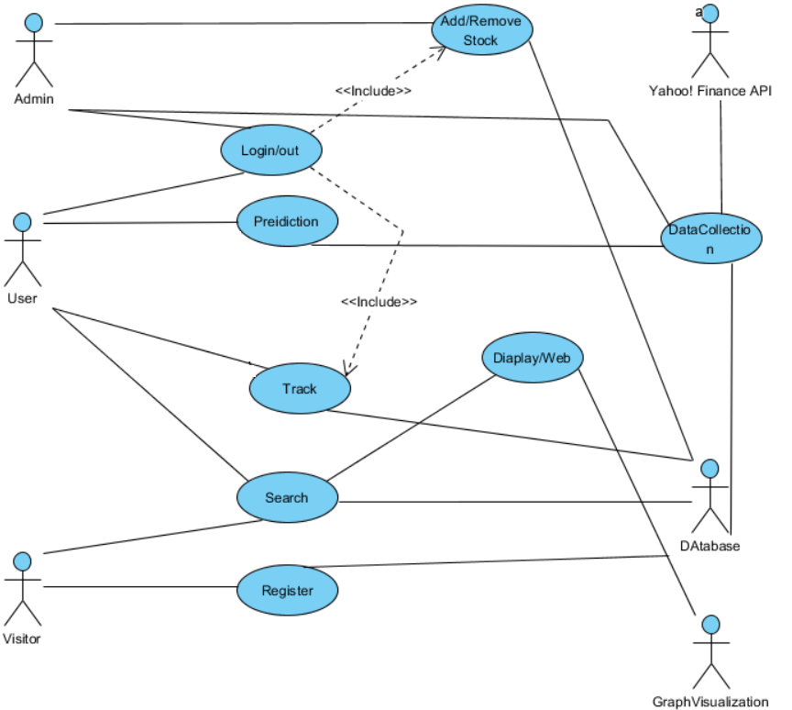
Use Case

Slide 3
FRONT-END
StockPre

Slide 4
Technical Details
JavaScript, Ajax, JSON, Jquery
HTML 5
PHP
PaaS
CDN
HTTPS
MySQL
Matlab

Slide 5
Technical Details - CDN
Before
After
PING ec2-54-85-48-36.compute-1.amazonaws.com (54.85.48.36): 56 data bytes 64 bytes from 54.85.48.36: icmp_seq=0 ttl=42 time=23.087 ms 64 bytes from 54.85.48.36: icmp_seq=1 ttl=42 time=22.981 ms 64 bytes from 54.85.48.36: icmp_seq=2 ttl=42 time=10.726 ms 64 bytes from 54.85.48.36: icmp_seq=3 ttl=42 time=9.327 ms 64 bytes from 54.85.48.36: icmp_seq=4 ttl=42 time=10.692 ms 64 bytes from 54.85.48.36: icmp_seq=5 ttl=42 time=9.534 ms 64 bytes from 54.85.48.36: icmp_seq=6 ttl=42 time=10.733 ms 64 bytes from 54.85.48.36: icmp_seq=7 ttl=42 time=11.720 ms 64 bytes from 54.85.48.36: icmp_seq=8 ttl=42 time=12.662 ms 64 bytes from 54.85.48.36: icmp_seq=9 ttl=42 time=11.102 ms ^C --- ec2-54-85-48-36.compute-1.amazonaws.com ping statistics --- 10 packets transmitted, 10 packets received, 0.0% packet loss round-trip min/avg/max/stddev = 9.327/13.256/23.087/4.972 ms
PING se2cdn.peterjiang.me (104.28.7.117): 56 data bytes 64 bytes from 104.28.7.117: icmp_seq=0 ttl=53 time=9.910 ms 64 bytes from 104.28.7.117: icmp_seq=1 ttl=53 time=9.631 ms 64 bytes from 104.28.7.117: icmp_seq=2 ttl=53 time=10.458 ms 64 bytes from 104.28.7.117: icmp_seq=3 ttl=53 time=8.728 ms 64 bytes from 104.28.7.117: icmp_seq=4 ttl=53 time=9.780 ms 64 bytes from 104.28.7.117: icmp_seq=5 ttl=53 time=9.832 ms 64 bytes from 104.28.7.117: icmp_seq=6 ttl=53 time=15.039 ms 64 bytes from 104.28.7.117: icmp_seq=7 ttl=53 time=8.891 ms 64 bytes from 104.28.7.117: icmp_seq=8 ttl=53 time=8.360 ms 64 bytes from 104.28.7.117: icmp_seq=9 ttl=53 time=9.488 ms 64 bytes from 104.28.7.117: icmp_seq=10 ttl=53 time=8.335 ms ^C --- se2cdn.peterjiang.me ping statistics --- 11 packets transmitted, 11 packets received, 0.0% packet loss round-trip min/avg/max/stddev = 8.335/9.859/15.039/1.763 ms

Slide 6
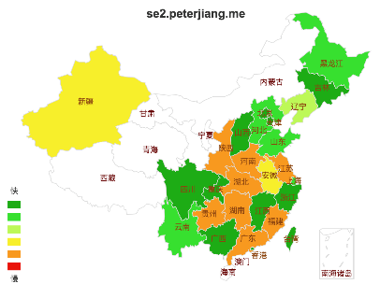
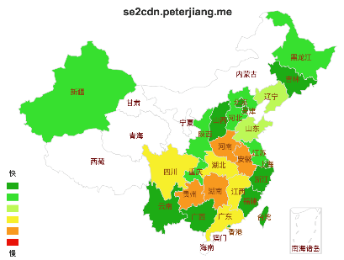
Technical Details - CDN
Before
After

Slide 7
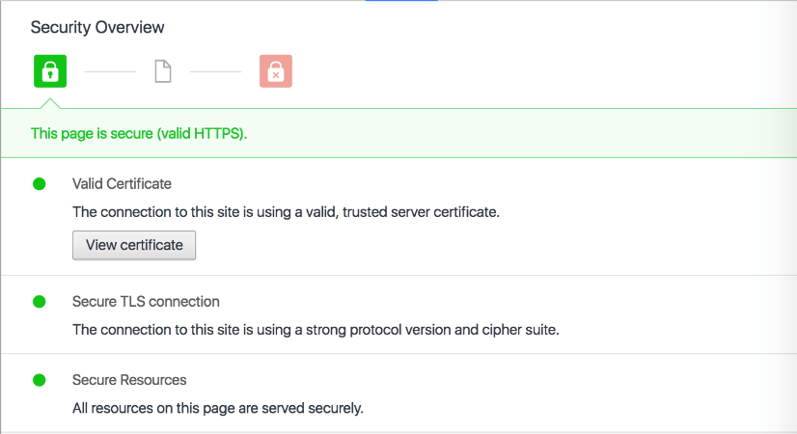
Technical Details - HTTPS

Slide 8
Technical Details - RWD
Responsive web design

Slide 9
PREDICTION ALGORITHM
StockPre

Slide 10
SVM
Input data: 5 days Open, High, Low, Close, Volume
Predict: Next day Close
We use past year data to train SVM, then get best parameter (c, gamma)to predict price.

Slide 11
RSI
Formulation: RSI=100×RS/(1+RS)
RS = 14days (Average Gain / Average Loss)
Input: history close price
output: Relative Strength Index

Slide 12
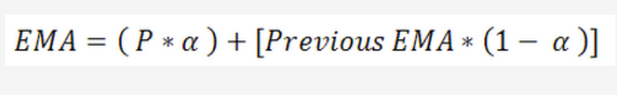
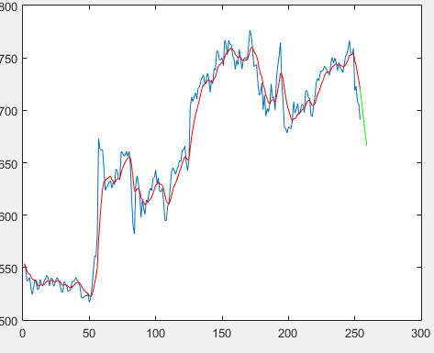
EMA
blue: close price
red: EMA
green: predict

Slide 13
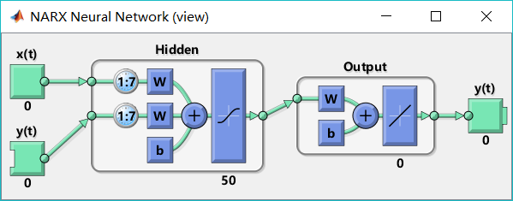
ANN
Long term prediction---Historical Data
50 Hidden layers
Delay of input is 7
Train Data
Input: Date
Target: Close Price

Slide 14
Bayesian
Short term prediction---Real-time Data
Input: Stock Price and Time
Output: The next minute’s price

Slide 15
THANK YOU!
StockPre

